Slide 2
Heroes at Home
Henderson County HELP Center
New Beginnings
Child Advocacy Program
Children’s Emergency Fund
UW Help Line
CASA of Trinity Valley
East Texas Council on Alcoholism & Drug Abuse
East Texas Arboretum
Labor of Love
Lila Lane Outreach
Boy Scouts of America
Alzheimer’s Coalition of Henderson County
American Red Cross
Meals on Wheels
East Texas Crisis Center
Disciples Clinic of Athens
Family Peace Project
Henderson County 4-H
Library at Cedar Creek Lake
Notes:
Henderson County United Way is proud to support these 16 organization who provide care and support to our community. These agencies keep your dollars local. 99 cents of every dollar support people in your community.
“A fair share is all any of us are asked to give…and when we do, it works for all of us…the UNITED WAY.”
WEBSITE: www.unitedwayhc.org

Slide 3
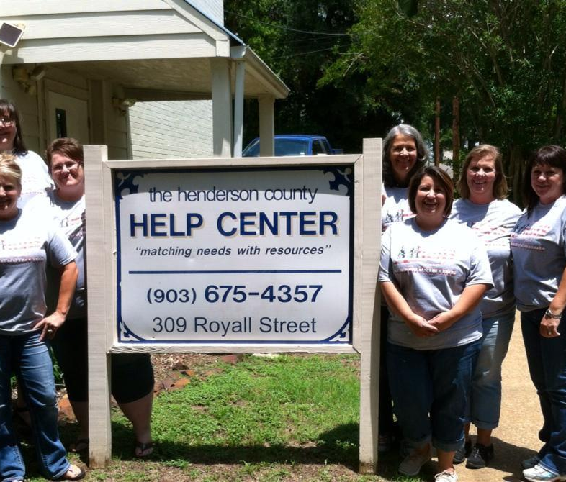
HC HELP Center
Providing support, care, health and well being to people of Henderson County.
Pregnancy, Education & Parenting
New Beginnings
After Baby Comes
Child Advocacy Center
United Way Help Line
Student Assistance Programs
Abstinence Education
Parents Anonymous
Notes:
A spin off of United Way itself, the United Way Helpline provides information and referral services to assist individuals in locating resources to match their needs. The United Way Helpline provides that constant thread by coordinating services throughout the county and reduces duplication of services. The HELP Line meets quarterly with other area non-profits to share information and resources; a Facebook page is also available for other community organizations to keep in touch, share ideas and post goings on in our community.

Slide 4
CASA of Trinity Valley
Mission: help children find safe, permanent homes as soon as possible and ultimately become healthy adult citizens.
Serving Children
Finding “Forever Homes”
Kids with a CASA Volunteer
Are less likely to be in long-term foster care
More likely to get the services they need
More likely to have a positive attitude toward the future
More likely to do well in school
Notes:
An umbrella program of the Henderson County HELP Center, The Henderson County Children’s Advocacy Center serves victims of abuse and neglect throughout the county. It is designed to reduce the trauma by reducing the time needed to process their cases through the court system. Coordinated law enforcement, Child Protective Services investigations and interviews are arranged in a neutral, child friendly setting. Additionally, counseling, medical services, mental health services and community referrals are provided, as well as child abuse prevention activities.

Slide 5
East Texas Council on Alcoholism & Drug Abuse
Mission: Provide substance abuse prevention and intervention services for residents of Henderson County.
Began in 1966
Services:
Substance Abuse Screening and Referral
Offender Education
School-Based Education
Notes:
The East Texas Council on Alcoholism and Drug Abuse (ETCADA) provides assistance for Henderson County residents who are seeking treatment for drug/alcohol/tobacco abuse addiction and referral to treatment. ETCADA maintains a crisis hotline which links individuals to a licensed counselor 24 hours per day/7 days per week. The ETCADA Prevention Resource Center serves as a regional clearing house for substance abuse literature, videos and speakers. Certified Prevention Specialist provide classroom training for schools, speakers and education for civic and community events.

Slide 6
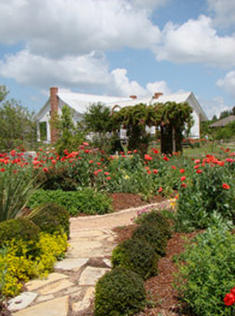
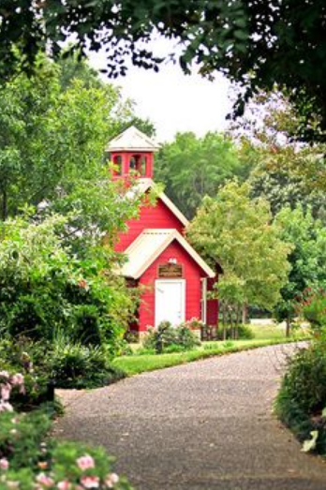
East Texas Arboretum
Mission: Display research and interpret natural environment of East Texas, to introduce species and provide educational activities for all.
Educational Opportunities for Children
Host school field trips
Community Events
Notes:
THE EAST TEXAS ARBORETUM
$5,000
The East Texas Arboretum is 104 acres of nature preserved land, just inside the city limits of Athens. A unique blend of horticulture and history, the grounds offer over 2 miles of nature trails, formal gardens, a museum, a working windmill pond area and a one room red school house. The Arboretum offers field trips to schools in Henderson County. These outdoor class rooms teach about the workings of nature in a setting far different than any class room. The Arboretum is also the home of the Henderson County Veterans Memorial wall. This outstanding memorial honors all the veterans from Henderson County who have served their country dating from the Civil War to present day. Currently there are over 9,500 names engraved on the walls. The East Texas Arboretum is a 501-3(c) non-profit organization.

Slide 7
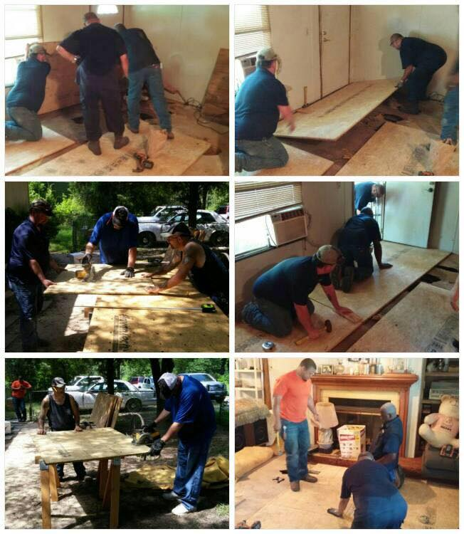
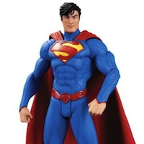
Labor of Love
Mission: Perform home repairs for individuals in Henderson County who own their home, but through circumstances beyond their control are unable to maintain them.
150+ projects a year
Thousands of Volunteer Hours
Wheel Chair Ramps
Repair Floors & Roofs
Bathroom Repairs
Notes:
LABOR OF LOVE
The Labor of Love’s efforts benefit the entire county, as needs are discovered. They assist not only in Athens, but also Brownsboro, Murchison, Tool, Bethel, LaRue, Sand Flats and others. An all-volunteer team helps rebuild homes, completes repairs, plumbing and whatever is needed. A committee carefully selects those most in need, and the United Way dollars provide supplies that cannot be obtained from donations.

Slide 8
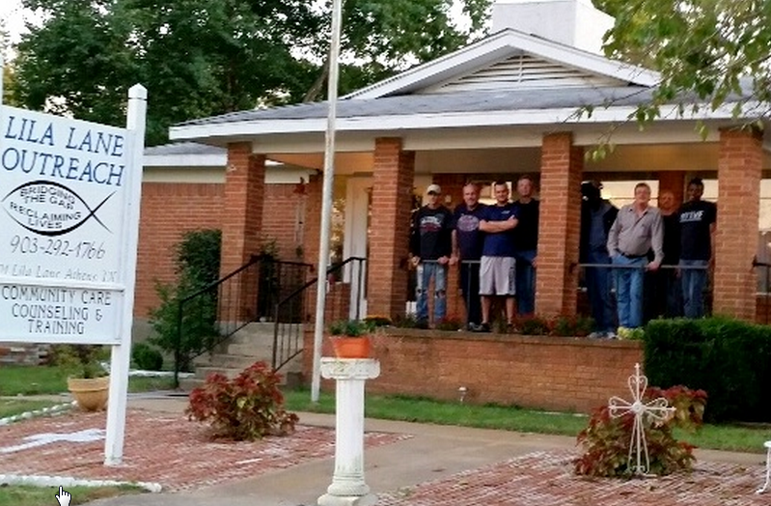
Lila Lane Outreach
Mission: Faith based treatment & recovery services for men only
Residential facility
Onsite counseling
Employee placement assistance
Notes:
LILA LANE OUTREACH
Lila Lane Outreach is a faith-based residential facility dedicated to helping men overcome their pasts. Services are designed to prevail over any kind of addiction, dependence and other self-defeating attitudes and behaviors. Lila Lane Outreach provides safe and secure housing with each individual having their “own space” within our dormitory setting.

Slide 9
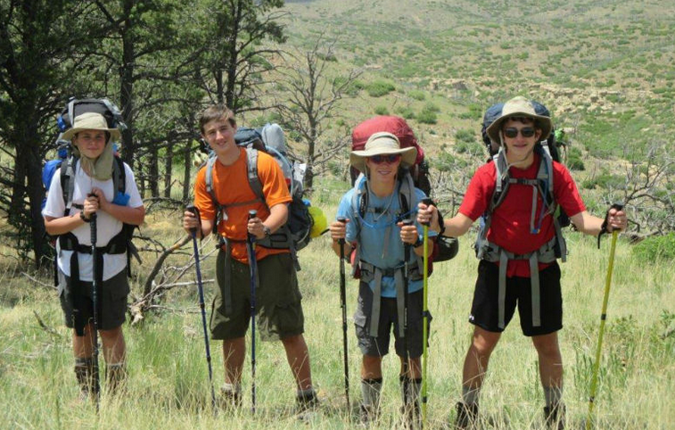
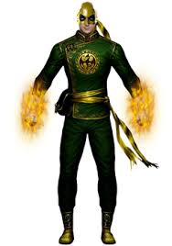
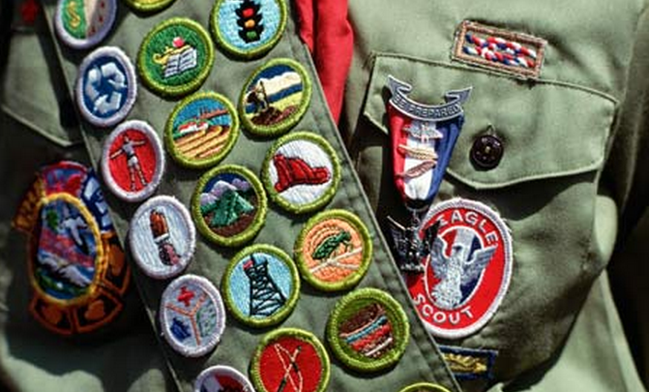
Boy Scouts of America – Troop 11
Notes:
HENDERSON COUNTY BOY SCOUTS – TROUP 11
Boy Scouts of America Troop 11 is proudly based in Athens at Living for the Brand Cowboy Church, located on Loop 7. This troop is growing at an incredible rate, and we’re proud to host an economically and ethnically diverse group of motivated young men. In fact, while there are a number of dedicated adults who supervise a wide range of activities, Troop 11 is run by the scouts themselves. An investment in Troop 11 is an investment in the future of Athens, Henderson County and beyond - as statistics often reveal Boy Scouts are more successful in their careers and families. Through their work on merit badges, camp outs and community service projects, these young men are equipped with the tools they will need to succeed for the rest of their lives.
HENDERSON COUNTY BOY SCOUTS – TROUP 342
They service the Brownsboro Independent School District to promote character development and values-based leadership training. The program consists of required training for personal, character and leadership development in all facets of life. In addition, the program provides opportunities for camping as well as other outdoor activities. There is also a requirement for community service projects.

Slide 10
Alzheimer’s Coalition of Henderson County
Mission: Provide support services for caregivers affected by Alzheimer’s or related dementias.
Offer respite services for care givers
Continuing education & services
Consultation
Referrals
Support Groups
Alzheimer’s Coalition
OF HENDERSON COUNTY
Notes:
ALZHEIMER’S COALITION OF HENDERSON COUNTY
$5,000

Slide 11
American Red Cross
Mission: prevent and alleviate human suffering in the face of emergencies.
Provide disaster relief
Temporary housing
Provide personal essentials
Armed services locator
Notes:
THE AMERICAN RED CROSS
Locally, the American Red Cross deals with communication to military families, and teaching standard First Aid and Adult CPR. They also help fire victims by providing immediate shelter, food and clothing. All money sent to the local chapter is used here in Henderson County.

Slide 12
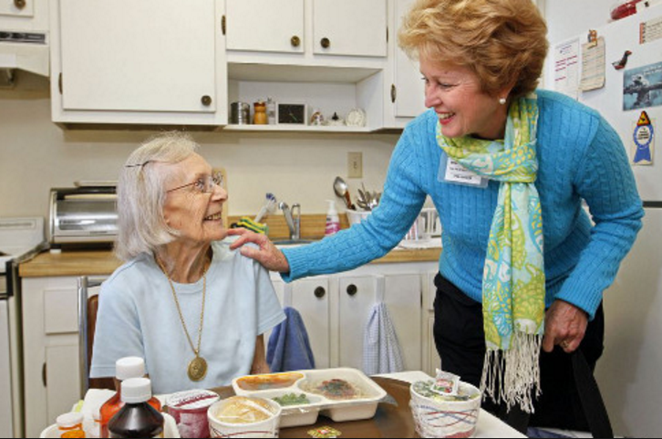
Meals on Wheels
Mission: to serve fresh-made, hot meals to homebound seniors and disabled individuals daily.
Serving East Texas since 1973
326 Henderson County Clients
83,000 Meals Delivered per Year
Notes:
MEALS ON WHEELS
Meals on Wheels served nearly 755,821 meals in Henderson County last year and more than a million across East Texas. With retired senior moving into the area, we plan to serve even more this year. We serve disabled and home-bound seniors in Athens, Chandler, Malakoff, Tool, Cedar Creek Lake and every other community in your county. Henderson County United Way funding will provide meals to those seniors who can’t afford to pay for food. Without this funding, many seniors would go hungry or be placed in a nursing home. This funding makes a vital difference to our program and to disabled, home-bound seniors across Henderson County.

Slide 13
East Texas Crisis Center, Inc.
Mission: to provide safety, shelter and education to victims of family violence, sexual assault and other violent crimes.
Serving Henderson County for 22 years
Provides services to both Children and Adults
Notes:
EAST TEXAS CRISIS CENTER
$6,000
East Texas Crisis Center Outreach office in Henderson County was opened in 1993. East Texas Crisis Center provides services to victims of Domestic Violence, Sexual Assault & other victims of crime. ETCC services include crisis intervention, shelter, counseling, legal advocacy, support groups, financial assistance, a women’s economic program and collaboration with community resources for victim assistance. Hotline service 24 hours a day and hospital on-call 7 days a week for abused and sexual assault victims.

Slide 14
Disciples Clinic of Athens, Texas
Mission: to provide low-cost, high-quality health care to the working uninsured of Henderson County
Basic medical and dental services
Laboratory testing
Prescription drug program
Radiology, mammography
Podiatry
Dietary counseling
Gynecological consultation
Notes:
DISCIPLES CLINIC OF ATHENS
$5,000
Disciples Clinic of Athens is a faith based clinic staffed by medical, dental and clerical volunteers providing high quality, low cost health and dental services for persons between the age of 19 and 64 who work at least 20 hours a week and whose income is less than the poverty level.

Slide 15
Family Peace Project
Mission: The education and awareness of domestic violence.
Provides assistance to victims of domestic violence
Short Term shelter
Transitional Housing
Client Services
Gas Vouchers
Transportation
Clothes/School Uniforms
Personal care items
Household items
Notes:
THE FAMILY PEACE PROJECT
$5,000
Since 1996, the Family Peace Project, a 501(e)3 non-profit organization, has been working to protect, educate, assist, care and empower victims of Domestic Violence and Sexual Assault in Henderson County, Texas. Protection is provided with the temporary shelter and security, away from the violence in their home Assistance to victims is accomplished through a collaborative effort with other agencies, organizations, churches, and the medical community to help the victims and their children break the cycle. The Family Peace Project endeavors to empower victims and their families by providing the tools to take care of their physical and spiritual needs to live a peaceful life.

Slide 16
Henderson County 4-H
Mission: Prepares youth to lead and succeed.
5000 students impacted by 4H programming
UW funds
New program
Competition and conference fees
Community Services such as transportation, concessions, refreshments etc.
Educational Materials
Notes:
HENDERSON COUNTY 4-H
$10,000
Henderson County 4-H programs prepare youth to meet the challenges of childhood, adolescence and adult, through a coordinated long-term, progressive series of educational experiences that enhance life skills and develop social, emotional, physical and cognitive competencies.

Slide 17
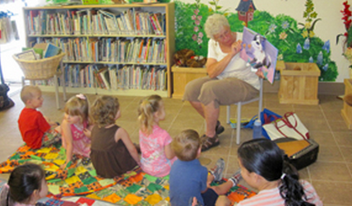
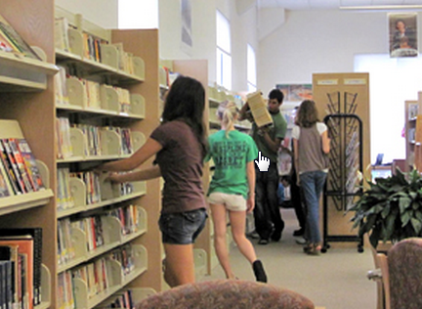
Library at Cedar Creek Lake
Mission: An advocate of reading, learning, and personal discovery. The Library aspires to provide a venue for people to meet, interact, learn, exchange ideas and information and grow!
Began as a bookmobile in 1970
20,000 visitors a year
Multiple Services & Programs
Wi-Fi & Internet Access
Downloadable E Books
Computer Training
Adult Literacy & ESL
Summer Reading
Photography Classes
Notes:
CEDAR CREEK LIBRARY
$2,500
Cedar Creek Library is a resource center that provides library materials and services, promotes and assists in educational development and encourages reading. Provides programs and activities that cater to the needs of all citizens.

